Slide 1
Algorithms
Chapter 3

Slide 2
Algorithms
Section 3.1

Slide 3
Section Summary
Introduction to Algorithms
Algorithms for Searching and Sorting
Greedy Algorithms
Stable Matchings
Halting Problem

Slide 4
Video 30: Algorithms
Introduction to Algorithms

Slide 5
What is an algorithm?
Finite set of well-defined, computer-implementable instructions to perform a specified task
to perform a computation
to solve a certain problem
to reach a certain destination

Slide 6
Example
Task: Find the maximum value in a finite sequence of integers.
Algorithm:
Set the temporary maximum equal to the first integer in the sequence.
Compare the next integer in the sequence to the temporary maximum. If it is larger than the temporary maximum, set the temporary maximum equal to this integer.
Repeat the previous step if there are more integers. If not, stop.
When the algorithm terminates, the temporary maximum is the largest integer in the sequence.

Slide 7
Example
Sequence 3 5 1 7 2 1
Temporary maximum 3 5 5 7 7 7

Slide 8
Specifying Algorithms
Algorithms can be specified in different ways.
Natural language
Pseudo-code
Programming language
Pseudocode is an intermediate step between an Natural Language description (more precise) and a coding of these steps using a programming language (more general).
Programmers can use the description of an algorithm in pseudocode to construct a program in a particular language.
Pseudocode helps us analyze the properties of an algorithm, independent of the actual programming language used to implement it.

Slide 9
Example
Task: Find the maximum value in a finite sequence of integers.
Algorithm in pseudocode:
procedure max(a₁, a₂, …., a_{n}: integers)
tmp_max := a₁
for i := 2 to n
if tmp_max < a_{i} then tmp_max := a_{i}
return tmp_max

Slide 10
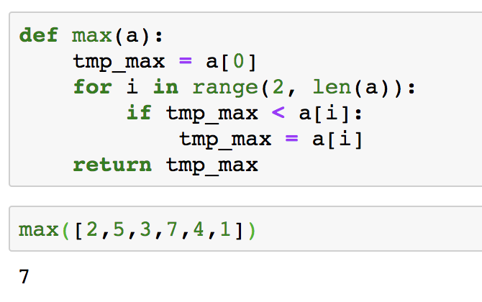
Example
Task: Find the maximum value in a finite sequence of integers.
Algorithm in Python:

Slide 11
Typical Problems Solved by Algorithms
Searching problems: finding the position of a particular element in a list.
Sorting problems: putting the elements of a list into increasing order.
Optimization Problems: determining the optimal value (maximum or minimum) of a particular quantity over all possible inputs.

Slide 12
Summary
Definition of Algorithm
Pseudocode
Types of Algorithms

Slide 13
Video 31: Searching Algorithms
Linear Search Algorithm
Binary Search Algorithm

Slide 14
Searching Problems
Task: Given a list S = a₁, a₂, a₃, …, a_{n} of distinct elements and some x, if x ∈ S return i such that a_{i} = x, else return 0.
Examples
Find a word in a dictionary
Find a name in a customer table
Find an amount in a bank transaction table

Slide 15
Linear Search Algorithm
The linear search algorithm locates an item in a list by examining elements in the sequence one at a time, starting at the beginning.
Algorithm
First compare x with a₁. If they are equal, return the position 1.
If not, try a₂. If x = a₂, return the position 2.
Keep going, and if no match is found when the entire list is scanned, return 0.

Slide 16
Linear Search Algorithm
procedure linear search(x: integer, a₁, a₂, …,a_{n}: distinct integers)
i := 1
while (i ≤ n and x ≠ a_{i})
i := i + 1
if i ≤ n then location := i else location := 0
return location

Slide 17
Example
Sequence 3 5 1 7 2 1
Searching x = 2
x ≠ a_{i} T T T T F
location 1 2 3 4 5 5 (returned)
Searching x = 4
x ≠ a_{i} T T T T T F
location 1 2 3 4 5 6 0 0 (returned)

Slide 18
Binary Search
Assume the input is a list of items in increasing order.
The algorithm begins by comparing the element to be found with the middle element.
If the middle element is lower, the search proceeds with the upper half of the list.
If it is not lower, the search proceeds with the lower half of the list (including the middle position).
Repeat this process until we have a list of size 1.
If the element we are looking for is equal to the element in the list, the position is returned.
Otherwise, 0 is returned to indicate that the element was not found.

Slide 19
Example
Binary search for 19 in the list:
1 2 3 5 6 7 8 10 12 13 15 16 18 19 20 22
The list has 16 elements, so the midpoint is 8. The value in the 8th position is 10. Since 19 > 10, further search is restricted to positions 9 through 16.
1 2 3 5 6 7 8 10 12 13 15 16 18 19 20 22
The midpoint of the current list (positions 9 through 16) is now the 12th position with a value of 16. Since 19 > 16, further search is restricted to the 13th position and above.
1 2 3 5 6 7 8 10 12 13 15 16 18 19 20 22
The midpoint of the current list is now the 14th position with a value of 19. Since 19 ≯ 19, further search is restricted to the portion from the 13th through the 14th positions .
1 2 3 5 6 7 8 10 12 13 15 16 18 19 20 22
The midpoint of the current list is now the 13th position with a value of 18. Since 19 > 18, search is restricted to the portion from the 14th position through the 14th.
1 2 3 5 6 7 8 10 12 13 15 16 18 19 20 22
Now the list has a single element and the loop ends. Since 19 = 19, the location 14 is returned.

Slide 20
Binary Search
procedure binary search(x: integer, a₁,a₂,…, a_{n}: increasing integers)
i := 1 {i is the left endpoint of interval}
j := n {j is right endpoint of interval}
while i < j {at least two elements in the list}
m := ⌊(i + j)/2⌋ {take the midpoint}
if x > a_{m} then i := m + 1 else j := m
if x = a_{i} then location := i else location := 0
return location

Slide 21
Summary
Search is a fundamental operation for data
Linear and Binary Search
Binary Search is more efficient, but requires sorting

Slide 22
Video 32: Sorting Algorithms
Bubble Sort
Insertion Sort

Slide 23
Sorting Problems
Task: Given a list S = a₁, a₂, a₃, …, a_{n}, return a list where the elements are put in increasing order.
Sorting is an important problem because:
A nontrivial percentage of all computing resources are devoted to sorting (e.g. in large databases)
An amazing number of fundamentally different algorithms have been invented for sorting
Sorting algorithms are useful to illustrate the basic notions of computer science.

Slide 24
Bubble Sort
Bubble sort makes multiple passes through a list.
In one pass, every pair of elements that are found to be out of order are interchanged.
Since the last element is guaranteed to be the largest after the first pass, in the second pass it needs no more to be inspected.
In every pass one more element at the end needs to be no more inspected.

Slide 25
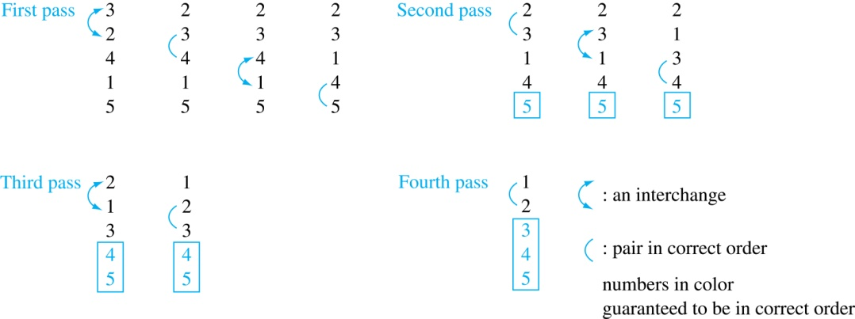
Example
At the first pass the largest element has been put into the correct position
At the end of the second pass, the 2nd largest element has been put into the correct position.
In each subsequent pass, an additional element is put in the correct position.

Slide 26
Bubble Sort
Bubble sort makes multiple passes through a list.
Every pair of elements that are found to be out of order are interchanged.
procedure bubblesort(a₁,…,a_{n}: real numbers with n ≥ 2)
for i := 1 to n − 1
for j := 1 to n − i
if a_{j} > a_{j+1} then interchange a_{j} and a_{j+1}

Slide 27
Insertion Sort
Insertion sort begins with the 2nd element.
It compares the 2nd element with the 1st and puts it before the first if it is not larger.
Next the 3rd element is put into the correct position among the first 3 elements.
In each subsequent pass, the j+1st element is put into its correct position among the first j+1 elements.
Linear search is used to find the correct position.

Slide 28
Example
Insertion sort with the input: 3 2 4 1 5
2 3 4 1 5 (first two positions are interchanged)
2 3 4 1 5 (third element remains in its position)
1 2 3 4 5 (fourth is placed at beginning)
1 2 3 4 5 (fifth element remains in its position)

Slide 29
Insertion Sort Pseudocode
procedure insertion sort(a₁,…,a_{n}: real numbers with n ≥ 2)
for j := 2 to n
i := 1
while a_{j} > a_{i} and i < j {move element a_{j} to right position}
i := i + 1
m := a_{j}
for k := 0 to j − i − 1 {shift elements to make place for a_{i}}
a_{j-k} := a_{j-k-1}
a_{i} := m
2 3 4 1 5 j = 4, i = 1 (after while)
1 2 3 4 5 m = a₄, j – i – 1 = 2, therefore a₄ := a₃ , a₃ := a₂ , a₂ := a₁ (for loop)
finally a₁ := m = a₄

Slide 30
Summary
Sorting is a fundamental operation for data
Bubble and Insertion Sort are basic algorithms
More efficient ones will be shown later

Slide 31
Video 33: Optimization Algorithms
Greedy Algorithms
Cashier’s Algorithm

Slide 32
Optimization Problems
Optimization problems minimize or maximize some parameter over all possible inputs
Examples
Finding a route between two cities with the smallest total mileage.
Determining how to encode messages using the fewest possible bits.
Finding the fiber links between network nodes using the least amount of fiber.

Slide 33
Greedy Algorithms
Optimization problems can often be solved using a greedy algorithm, which makes the “best” choice at each step.
Making the “best choice” at each step does not necessarily produce an optimal solution to the overall problem
but in many instances, it does.
After specifying the greedy algorithm,
Either we prove that this approach always produces an optimal solution
or we find a counterexample to show that it does not.

Slide 34
Cashier’s Algorithm
Task: Find for an amount of any n cents the least total number of coins using the following coins: quarters (25 cents), dimes (10 cents), nickels (5 cents), and pennies (1 cent).
(Greedy) Idea: At each step choose the coin with the largest possible value that does not exceed the amount left.

Slide 35
Example
Change for n = 67 cents.
First choose a quarter leaving 67−25 = 42 cents.
Then choose another quarter leaving 42 −25 = 17 cents
Then choose 1 dime, leaving 17 − 10 = 7 cents.
Choose 1 nickel, leaving 7 – 5 = 2 cents.
Choose a penny, leaving one cent.
Choose another penny leaving 0 cents.
A total of 6 coins have been used.

Slide 36
Cashier’s Algorithm
The algorithm works with any coin denominations c₁, c₂, …, c_{r}
For the example of U.S. currency, we have quarters, dimes, nickels and pennies, with c₁ = 25, c₂ = 10, c₃ = 5, and c₄ = 1.
procedure change(c₁, c₂, …, c_{r}: values of coins, where c₁> c₂> … > c_{r} ; n: a positive integer)
for i := 1 to r {start with the largest coins}
d_{i} := 0 {d_{i} counts the coins of denomination c_{i}}
while n ≥ c_{i}
d_{i} := d_{i} + 1 {add a coin of denomination c_{i}}
n = n – c_{i} {remove the value of the coin}
return d₁, d₂, …, d_{r}

Slide 37
Proving Optimality
Show that the change making algorithm for U.S. coins is optimal.
Lemma 1: If n is a positive integer, then n cents in change using quarters, dimes, nickels, and pennies, using the fewest coins possible
has at most 2 dimes, 1 nickel, 4 pennies
cannot have 2 dimes and 1 nickel
the total amount of change in dimes, nickels, and pennies cannot exceed 24 cents.

Slide 38
Proof of Lemma 1
Proof:
Property 1: By contradiction (not the fewest coins)
If we had 3 dimes, we could replace them with a quarter and a nickel.
If we had 2 nickels, we could replace them with 1 dime.
If we had 5 pennies, we could replace them with a nickel.
Property 2: By contradiction (not the fewest coins)
If we had 2 dimes and 1 nickel, we could replace them with a quarter.
Property 3: is a consequence
The largest allowable combination, 2 dimes and 4 pennies, has a maximum value of 24 cents.

Slide 39
Proving Optimality
Theorem: The greedy change-making algorithm for U.S. coins produces change using the fewest coins possible.
Proof: By contradiction.
Assume there is a positive integer n such that change can be made with a fewer total number of coins than given by the algorithm.
Let q’ be the number of quarters used in this optimal solution
q’ ≤ q , since the greedy algorithm uses the maximum number of quarters possible
q’ < q is not possible since then we would have more than 25 cents in dimes, nickels, and pennies, which contradicts Lemma 1.
Therefore q’ = q
Similarly the greedy algorithm chose the maximum possible number of dimes
we cannot replace a dime by at most 1 nickel and 4 pennies of value 9.
Similarly the greedy algorithm chose the maximum number of nickels, and therefore also the number of nickels and pennies is the same.

Slide 40
Cashier’s Algorithm Discussion
Optimality depends on the denominations available.
If we allow only quarters (25 cents), dimes (10 cents), and pennies (1 cent), the algorithm no longer produces the minimum number of coins.
Counterexample: Consider the example of 31 cents.
The optimal number of coins is 4, i.e., 3 dimes and 1 penny.
The algorithm outputs 1 quarter and 6 dimes.

Slide 41
Summary
Greedy Algorithms
Cashier’s Algorithm
Optimality Proof

Slide 42
Video 34: Stable Matchings
Matching
Maximum Matching
Stable Matching
Greedy Algorithm for finding the Stable Matching

Slide 43
Stable Matchings
Task: Pair elements from equally sized two groups considering their preferences for members of the other group so that there are no ways to improve the preferences.
This requires first some definitions …

Slide 44
Matchings
Definition: Given a finite set A, a matching of A is a set of (unordered) pairs of distinct elements of A where any element occurs in at most one pair (such pairs are called independent).
Definition: A maximum matching is a matching that contains the largest possible number of pairs.

Slide 45
Examples
Let A = {1, 2, 3, 4}
{(1, 2)} and {(1, 3), (2, 4)} are matchings
{(2, 2)} and {(1, 2), (2, 4)} are not matchings
{(1,3),(2,4)} is a maximum matching
Let A = {1, 2, 3, 4, 5}
{(1, 3), (2, 4)} and {(5, 3), (2, 4)} are maximum matchings

Slide 46
Preferences
A preference list L_{x} defines for every element x ∈ A the order in which the element prefers to be paired with. x ∈ A prefers y to z if y precedes z on L_{x}.
Example: A = {Lou, Glenn, Bobbie, Tyler}
L_{Lou} =(Glenn, Bobbie, Tyler)
L_{Glenn} =(Bobbie, Lou, Tyler)
L_{Bobbie} =(Lou, Glenn, Tyler)
L_{Tyler} =(Lou, Glenn, Bobbie)
Lou prefers Glenn over Bobbie, and Bobbie over Tyler

Slide 47
Stability of Matching
Definition: A matching is unstable if there are two pairs (x, y), (v, w) in the matching such that x prefers v to y and v prefers x to w.
Definition: A stable matching is a matching that is not unstable.
Example: {(Glenn, Lou), (Bobbie, Tyler)} is unstable
L_{Glenn} =(Bobbie, Lou, Tyler): Glenn prefers Bobbie over Lou
L_{Bobbie} =(Lou, Glenn, Tyler): Bobbie prefers Glenn over Tyler
Therefore Glenn and Bobbie will leave their current partner and pair up.

Slide 48
Stability of Matching
New matching: {(Glenn, Bobbie), (Lou, Tyler)}
L_{Lou} =(Glenn, Bobbie, Tyler): Lou prefers Bobbie
L_{Bobbie} =(Lou, Glenn, Tyler): Bobbie prefers Lou
Therefore Lou and Bobbie will leave their current partner and pair up.
New matching: {(Lou, Bobbie), (Glenn, Tyler)}
L_{Lou} =(Glenn, Bobbie, Tyler): Lou prefers Glenn
L_{Glenn} =(Bobbie, Lou, Tyler): Glenn prefers Lou
New matching {(Glenn, Lou), (Bobbie, Tyler)} is initial matching
There does not exist a stable maximal matching!

Slide 49
Marriage Problem
To guarantee, irrespective of the preference lists, the existence of a stable maximum matching it suffices to use a more stringent pairing rule.
Definition: Given a set with even cardinality, partition A into two disjoint subsets A₁ and A₂ with A₁ ∪ A₂ = A and |A₁| = |A₂|. A matching is a bijection from the elements of one set to the elements of the other set.
That means, that pairs can only consist of one element of A₁ and A₂ each.

Slide 50
Example
Assume A₁ = {Lou, Glenn} and A₂ = {Bobbie, Tyler}
We have to adapt the preference lists
L_{Lou} = (Bobbie, Tyler)
L_{Glenn} = (Bobbie, Tyler)
L_{Bobbie} = (Lou, Glenn)
L_{Tyler} = (Lou, Glenn)
Now {(Lou, Bobbie), (Glenn, Tyler)} is stable
{(Bobbie, Glenn), (Lou, Tyler)} is unstable (Lou prefers Bobbie, Bobbie prefers Lou)

Slide 51
Existence of Stable Maximum Matching
A greedy algorithm to construct a stable maximum matching for the marriage problem
It proofs existence of stable matching
It is efficient
(and it produced a Nobel price)

Slide 52
Gale-Shapley Algorithm
Let M be the set of pairs under construction;
Initially M = ∅
While |M| < | A₁ |:
Select an unpaired x ∈ A₁
Let x propose to the first element y ∈ A₂ on L_{x}:
if y is unpaired then add the pair (x, y) to M
else (i.e., if y is paired already)
Let x’ ∈ A₁ be the element that y is paired to, (i.e., (x’, y) ∈ M)
if x’ precedes x on L_{y} then remove y from L_{x}
else (i.e., if x precedes x’ on L_{y})
Replace (x’, y) ∈ M by (x, y) and remove y from L_{x’}

Slide 53
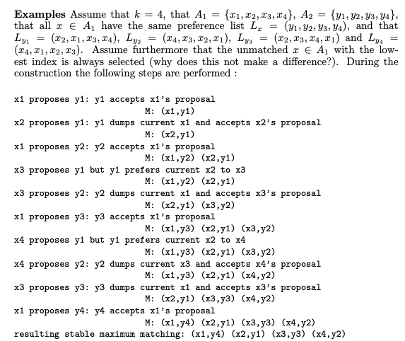
Example

Slide 54
Summary
Definition of Maximum Stable Matching
Gale-Shapley Algorithm
Shows existence of maximum stable matching

Slide 55
Video 35: Halting Problem
Definition of Halting Problem
A Famous Theorem

Slide 56
Unsolvable Problems
Can every problem by solved by an algorithm?
Answer (Turing): No!
He defined an unsolvable problem, the halting problem: Can we develop a procedure that takes as input a computer program along with its input and determines whether the program will eventually halt with that input?

Slide 57
Halting Problem
Theorem: The halting problem that cannot be solved using any procedure.
The proof requires an accurate description of what is a procedure, the input and output and of how a procedure can be encoded as string (Turing machine).

Slide 58
Proof Sketch
Assume that there is such a procedure and call it H(P, I).
The procedure H(P, I) takes as input a program P and the input I to P.
H outputs “halt” if it is the case that P will stop when run with input I.
Otherwise, H outputs “loops forever.”
Construct a procedure K(P), which works as follows.
If H(P, P) outputs “loops forever” then K(P) halts.
If H(P, P) outputs “halt” then K(P) goes into an infinite loop

Slide 59
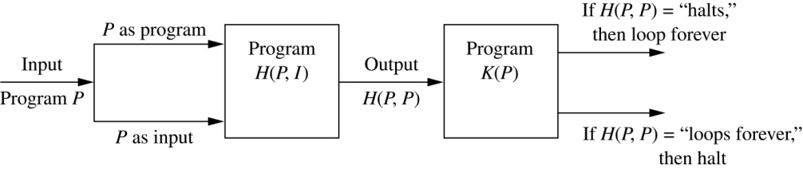
Proof Sketch
Now we call K with K as input, i.e. K(K).
If the output of H(K, K) is “loops forever” then K(K) halts. A Contradiction.
If the output of H(K, K) is “halts” then K(K) loops forever. A Contradiction.
Therefore, there can not be a procedure that can decide whether or not an arbitrary program halts.

Slide 60
Summary
Concept of Algorithm
Searching and Sorting Algorithms
Greedy algorithms take locally the best decisions
Algorithms can show the existence of a solution to a problem
Not every problem can be solved by an algorithm

